Slide 1
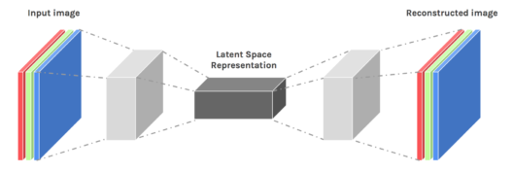
What are Autoencoders?
An autoencoder neural network is an Unsupervised Machine learning algorithm that applies backpropagation, setting the target values to be equal to the inputs. Autoencoders are used to reduce the size of our inputs into a smaller representation. If anyone needs the original data, they can reconstruct it from the compressed data.

Slide 2
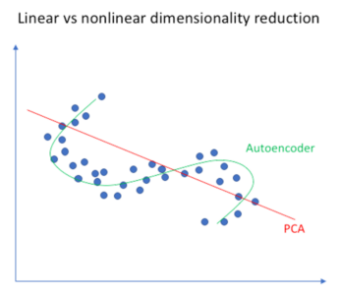
Autoencoders Tutorial: Its Emergence
Autoencoders are preferred over PCA because:
An autoencoder can learn non-linear transformations with a non-linear activation function and multiple layers.
It doesn’t have to learn dense layers. It can use convolutional layers to learn which is better for video, image and series data.
It is more efficient to learn several layers with an autoencoder rather than learn one huge transformation with PCA.
An autoencoder provides a representation of each layer as the output.
It can make use of pre-trained layers from another model to apply transfer learning to enhance the encoder/decoder.
Now let’s have a look at a few Industrial Applications of Autoencoders.

Slide 3
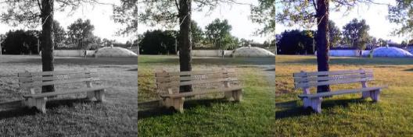
Applications of Autoencoders
Image Coloring
Autoencoders are used for converting any black and white picture into a colored image. Depending on what is in the picture, it is possible to tell what the color should be

Slide 4
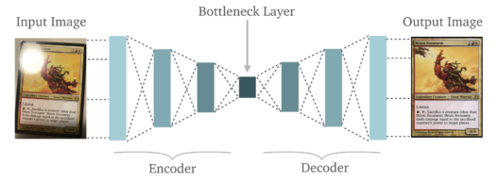
Applications of Autoencoders
Feature variation
It extracts only the required features of an image and generates the output by removing any noise or unnecessary interruption.

Slide 5
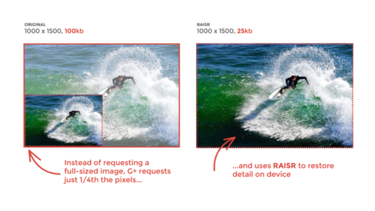
Applications of Autoencoders
Dimensionality Reduction
The reconstructed image is the same as our input but with reduced dimensions. It helps in providing the similar image with a reduced pixel value.

Slide 6
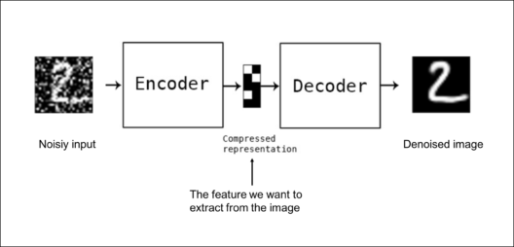
Applications of Autoencoders
Denoising Image
The input seen by the autoencoder
is not the raw input but a
stochastically corrupted version.
A denoising autoencoder is thus
trained to reconstruct the original input from the noisy version.

Slide 7

Applications of Autoencoders
Watermark Removal
It is also used for removing watermarks from images or to remove any object while filming a video or a movie.
Now that you have an idea of the different industrial applications of Autoencoders, let’s continue our Autoencoders Tutorial Blog and understand the complex architecture of Autoencoders.

Slide 8
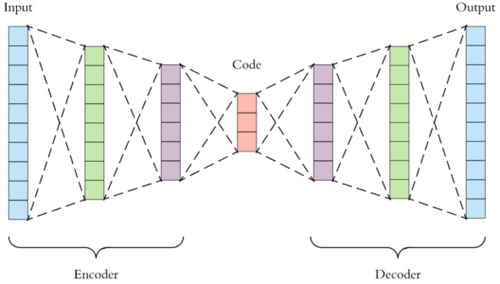
Architecture of Autoencoders

Slide 9
Architecture of Autoencoders
Encoder: This part of the network compresses the input into a latent space representation. The encoder layer encodes the input image as a compressed representation in a reduced dimension. The compressed image is the distorted version of the original image.
Code: This part of the network represents the compressed input which is fed to the decoder.
Decoder: This layer decodes the encoded image back to the original dimension. The decoded image is a lossy reconstruction of the original image and it is reconstructed from the latent space representation.

Slide 10
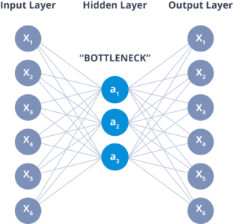
Architecture of Autoencoders
The layer between the encoder and decoder, ie. the code is also known as Bottleneck. This is a well-designed approach to decide which aspects of observed data are relevant information and what aspects can be discarded. It does this by balancing two criteria :
Compactness of representation, measured as the compressibility.
It retains some behaviourally relevant variables from the input

Slide 11
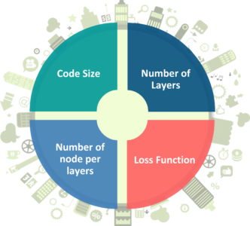
Hyperparameters of Autoencoders:
There are 4 hyperparameters that we need to set before training an autoencoder:
Code size: It represents the number of nodes in the middle layer. Smaller size results in more compression.
Number of layers: The autoencoder can consist of as many layers as we want.
Number of nodes per layer: The number of nodes per layer decreases with each subsequent layer of the encoder, and increases back in the decoder. The decoder is symmetric to the encoder in terms of the layer structure.
Loss function: We either use mean squared error or binary cross-entropy. If the input values are in the range [0, 1] then we typically use cross-entropy, otherwise, we use the mean squared error.

Slide 12
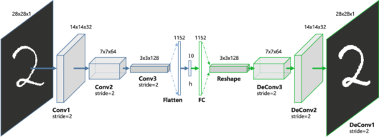
Types of Autoencoders
Convolution Autoencoders
Autoencoders in their traditional formulation does not take into account the fact that a signal can be seen as a sum of other signals. Convolutional Autoencoders use the convolution operator to exploit this observation. They learn to encode the input in a set of simple signals and then try to reconstruct the input from them, modify the geometry or the reflectance of the image.

Slide 13
Use cases of CAE:
Image Reconstruction
Image Colorization
latent space clustering
generating higher resolution images

Slide 14
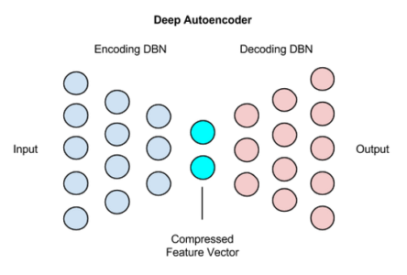
Deep Autoencoders
The extension of the simple Autoencoder is the Deep Autoencoder. The first layer of the Deep Autoencoder is used for first-order features in the raw input. The second layer is used for second-order features corresponding to patterns in the appearance of first-order features. Deeper layers of the Deep Autoencoder tend to learn even higher-order features.
A deep autoencoder is composed of two, symmetrical deep-belief networks-
First four or five shallow layers representing the encoding half of the net.
The second set of four or five layers that make up the decoding half.

Slide 15
Use cases of Deep Autoencoders
Image Search
Data Compression
Topic Modeling & Information Retrieval (IR)

Slide 16
Denoising Autoencoders
There is another way to force the autoencoder to learn useful features, which is adding random noise to its inputs and making it recover the original noise-free data.
This way the autoencoder can’t simply copy the input to its output because the input also contains random noise.
We are asking it to subtract the noise and produce the underlying meaningful data. This is called a denoising autoencoder.

Slide 17
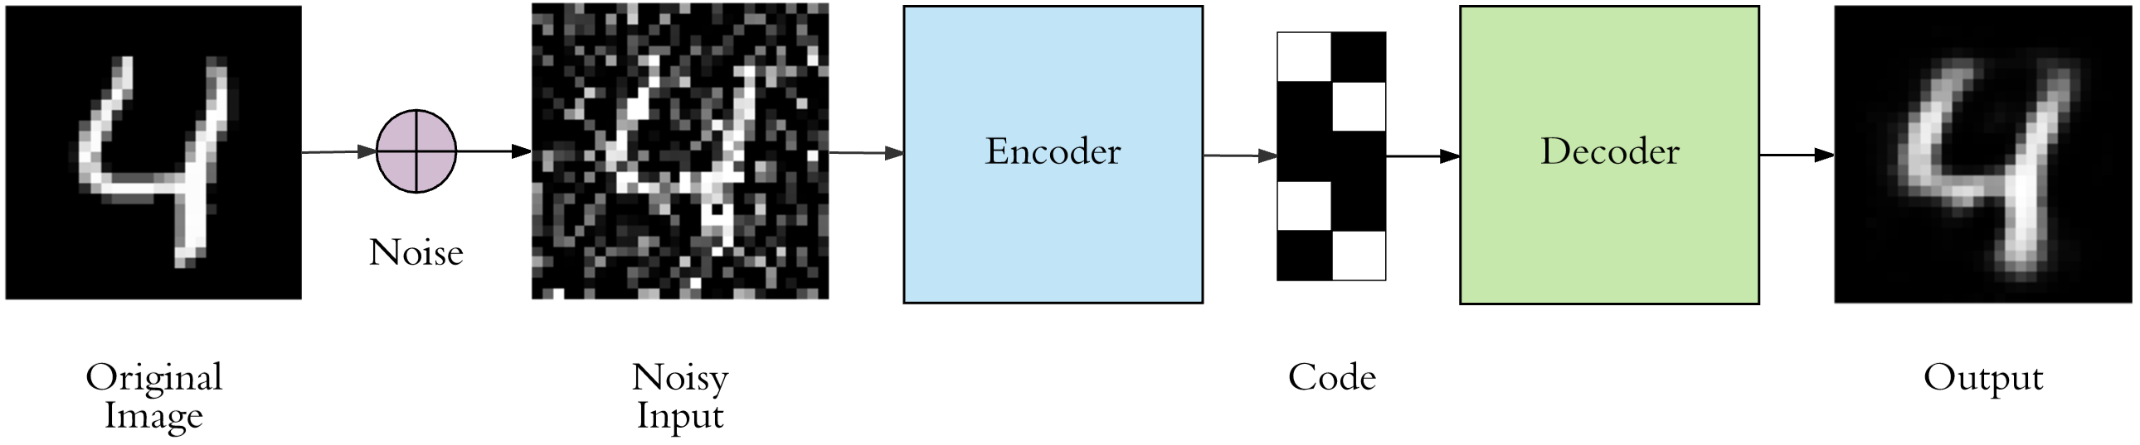

Slide 18
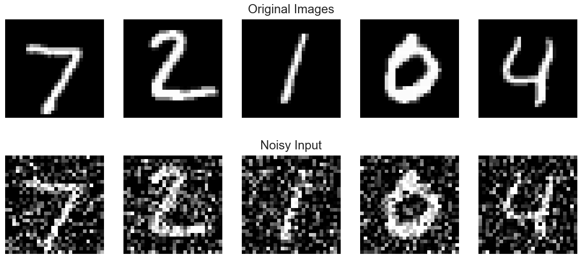
The top row contains the original images. We add random Gaussian noise to them and the noisy data becomes the input to the autoencoder. The autoencoder doesn’t see the original image at all. But then we expect the autoencoder to regenerate the noise-free original image.

Slide 19
Sparse Autoencoders
We introduced two ways to force the autoencoder to learn useful features: keeping the code size small and denoising autoencoders. The third method is using regularization.
We can regularize the autoencoder by using a sparsity constraint such that only a fraction of the nodes would have nonzero values, called active nodes.
In particular, we add a penalty term to the loss function such that only a fraction of the nodes become active. This forces the autoencoder to represent each input as a combination of small number of nodes, and demands it to discover interesting structure in the data.
This method works even if the code size is large, since only a small subset of the nodes will be active at any time.

Slide 20
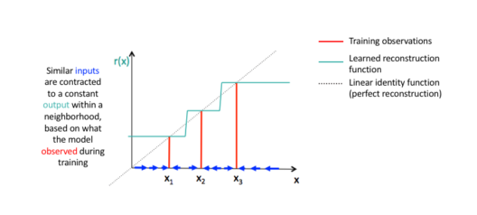
Contractive Autoencoders
A contractive autoencoder is an unsupervised deep learning technique that helps a neural network encode unlabeled training data. This is accomplished by constructing a loss term which penalizes large derivatives of our hidden layer activations with respect to the input training examples, essentially penalizing instances where a small change in the input leads to a large change in the encoding space.

Slide 21
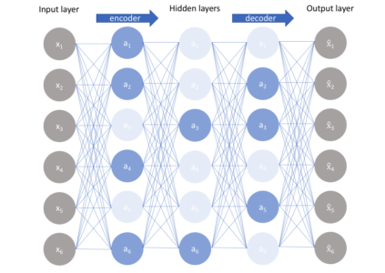
Sparse Autoencoders
Sparse autoencoders offer us an alternative method for introducing an information bottleneck without requiring a reduction in the number of nodes at our hidden layers. Instead, we’ll construct our loss function such that we penalize activations within a layer.

Slide 22
